Slide 2
IFEB collection Institut français d’études byzantines, Paris
Geneva Museum of Art
Epigraphic and Numismatic Museum of Athens
Zacos collection BnF, Paris
Robert Feind’s private collection, Cologne
Dumbarton Oaks Seals Collection

Slide 3
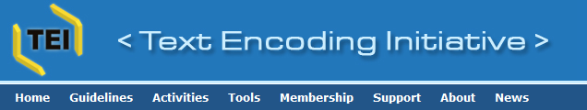


XML – eXtensible Markup Language
TEI XML
EpiDoc
EFES
SigiDoc’s «Geneaology»
Specific and original work on seals
SigiDoc
IFEB collection Institut français d’études byzantines, Paris
Dumbarton Oaks Seals Collection
Geneva Museum of Art
Epigraphic and Numismatic Museum of Athens
Zacos collection BnF, Paris
Robert Feind’s private collection, Cologne
Spreading
Virtually unified sigillographic corpus through common search interface

Slide 4
XML – eXtensible Markup Language
TEI XML
SigiDoc’s «geneaology»
Specific and original work on sigillographic standards of edition
SigiDoc
IFEB collection Institut français d’études byzantines, Paris
Dumbarton Oaks Seals Collection
Geneva Museum of Art
Epigraphic and Numismatic Museum of Athens
Zacos collection BnF, Paris
Robert Feind’s private collection, Cologne
Spreading
Virtually unified sigillographic corpus through common search interface

Slide 5
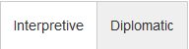
<titleStmt/>
Title
<physDesc/>
<origDate/>
<history/>
Artifact
Physical description
Dating
History
<teiHeader/>
<msPart n="r"/>
<msPart n="v"/>
Inscribed field – Obverse
Inscribed field – Reverse
<textLang/>
<div type="bibliography"/>
Text
<facsimile/>
<graphic/>
Images
<div type="edition"/>
<text/>
<div type="apparatus"/>
<div type="translation"/>
<div type="commentary"/>
Apparatus criticus
Translation
Commentary

Slide 6
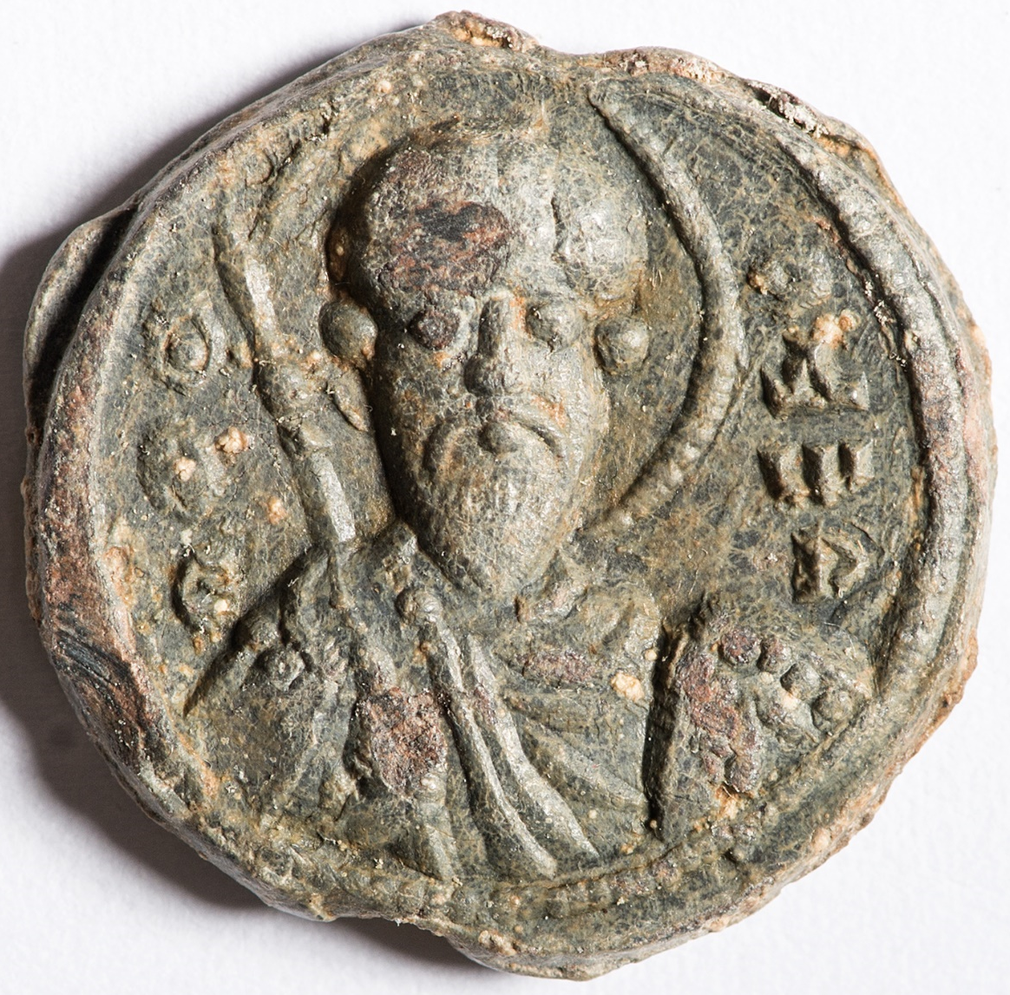
<text> <body> <div type="edition" subtype="editorial" xml:space="preserve" xml:lang="grc"> <div type="textpart" subtype="label" n="obv" rend="linear"> <ab>[Greek or Latin... text here]</ab> </div> <div type="textpart" subtype="face" n="obv" rend="linear"> <ab>[Greek or Latin... text here]</ab> </div> <div type="textpart" subtype="label" n="rev" rend="linear"> <ab>[Greek or Latin... text here]</ab> </div> <div type="textpart" subtype="face" n="rev" rend="linear"> <ab>[Greek or Latin... text here]</ab> </div> </div> <div type="edition" subtype="diplomatic" xml:space="preserve" xml:lang="grc"> <!-- for nested elements, see the previous --> </div> <div type="apparatus"> <listApp> <app xml:lang="xx"></app> </listApp> </div> <div type="translation"> <p xml:lang="xx"></p> </div> <div type="commentary" subtype="edition"> <p xml:lang="xx"></p> </div>

